Slide 1

Best “Better” Coding Practices
Managing your coding projects for homework and research so you don’t hate yourself in six months time
Tom Logan
tomlogan@umich.edu

Slide 2
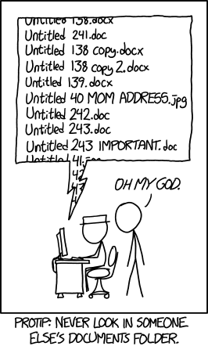

Slide 3
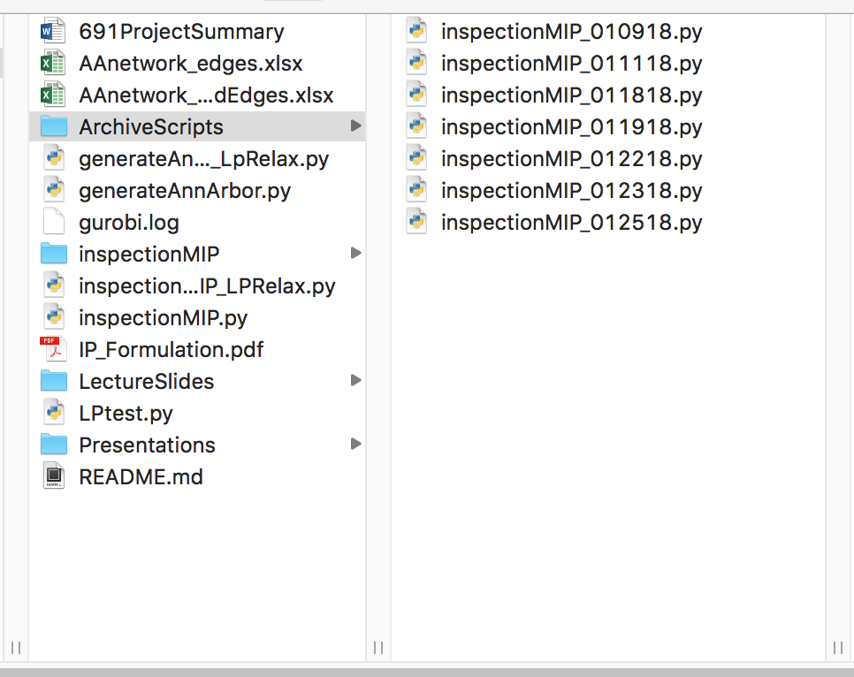
Real example
They want to update their code, but save versions that are working
Hence “ArchiveScripts”
This is good. But
It’s not clear to collaborators
It’s poorly documented
It’s far from fool proof

Slide 4
Shout out to Jeff Leek - inspiration
How to be a modern scientist by Jeff Leek – very short and sweet guide to doing research and coding (highly recommend)

Slide 5
Jenny Bryan
“Your closest collaborator is you six months ago, but you don’t reply to emails.”
“If the thought of re-running your analysis makes you ill, you’re not doing it right.”

Slide 6
Equiping ourselves for future
While the world has changed rapidly, academia has not.
Limitations of “the paper”
a brief summary of a research project
no access to all the data, code, other learning etc.
Alternative is “Github of Science”
Open-source
Continuous, collaborative development
Incentive changes are necessary, but let’s equip ourselves

Slide 7
Why we’re here
Version control, better file history, and back ups
A cleaner and more organized directory and file structure
Readable code that you, your future self, and collaborators can understand
Improved documentation of your projects
Better workflow which integrates analysis and writing
Making your life easier!

Slide 8
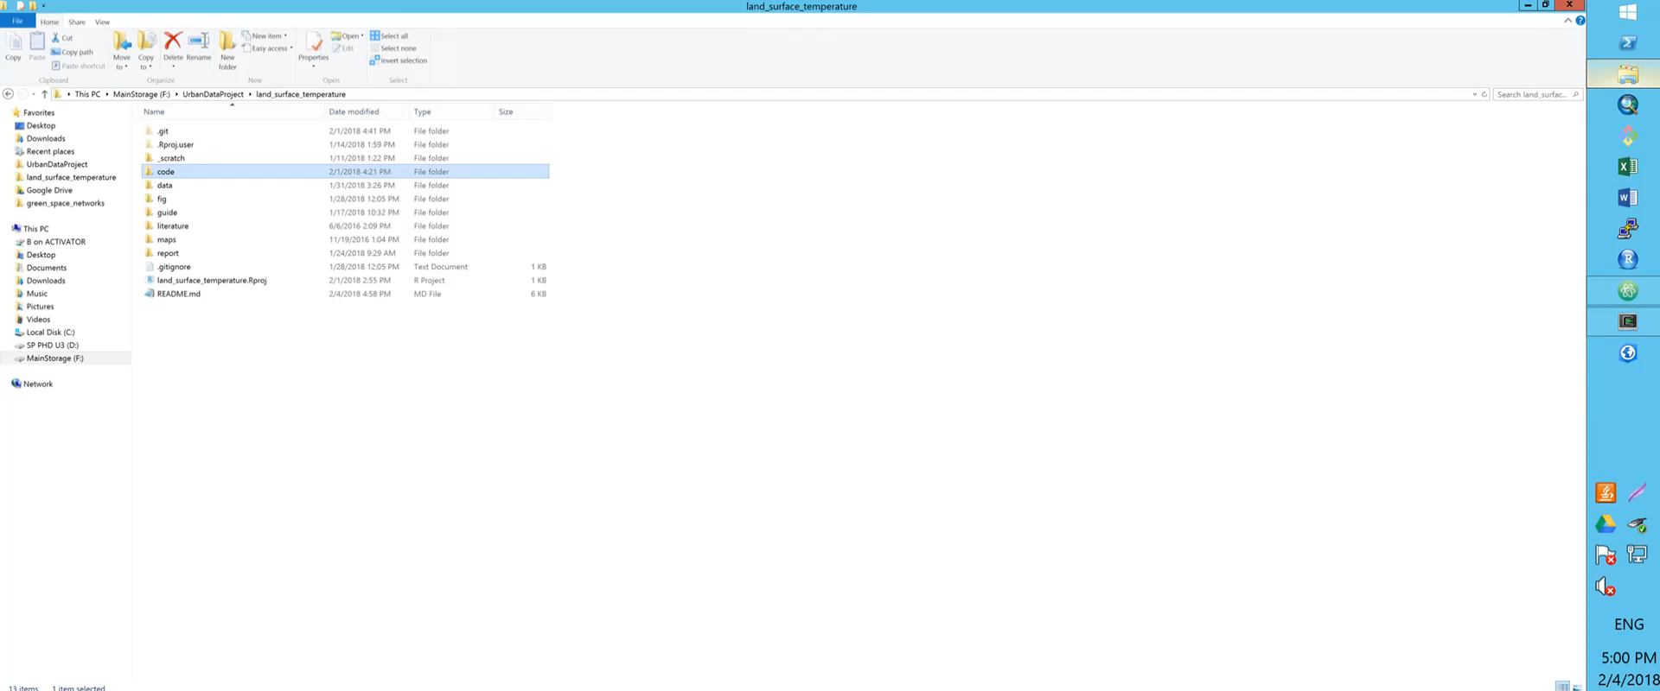
For example

Slide 9
Outline
Before the workshop
Github -> version control
Repository/directory structure
Atom
Markdown and README
Rstudio
Reproducibility and interpretability
ShareLaTeX
Logging

Slide 10
Before the workshop 1/2
Have a code project folder that you’d like to clean up or start building or at least have one in mind
Install Atom or other text editor
Create yourself a profile on github.com AND get the student developers pack
https://education.github.com/pack
Create an account on ShareLaTeX (optional)
https://www.sharelatex.com

Slide 11
Before the workshop 2/2
WINDOWS
MAC
Show hidden files, folders and drives
Install git (just steps 1-11): https://www.develves.net/blogs/asd/articles/using-git-with-powershell-on-windows-10/#installing-git
In the terminal run
xcode-select –install
brew install git-lfs
LINUX
In the terminal run
apt-get install git
apt-get install git-lfs

Slide 12
Think about a) project you are working on or b) one that you are about to start

Slide 13


Why
Version control – it tracks the entire history of a doc so you can
Go back
Compare changes
See how you did something
Version control is one of those things that you don’t need, until you really really really need it.
Applies to code and reports/documents (but not data)
Notes:
How many people have changed code and got something to work and later realized that in doing so, they screwed up something else?

Slide 14

Alternative
gitlab.eecs.umich.edu
This has the advantage of being UM hosted

Slide 15
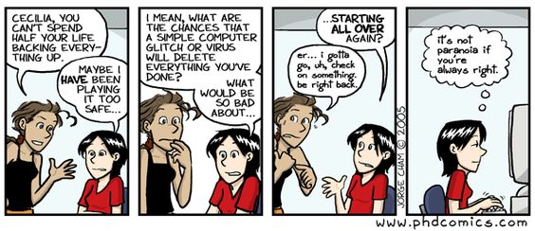
Version control

Slide 16
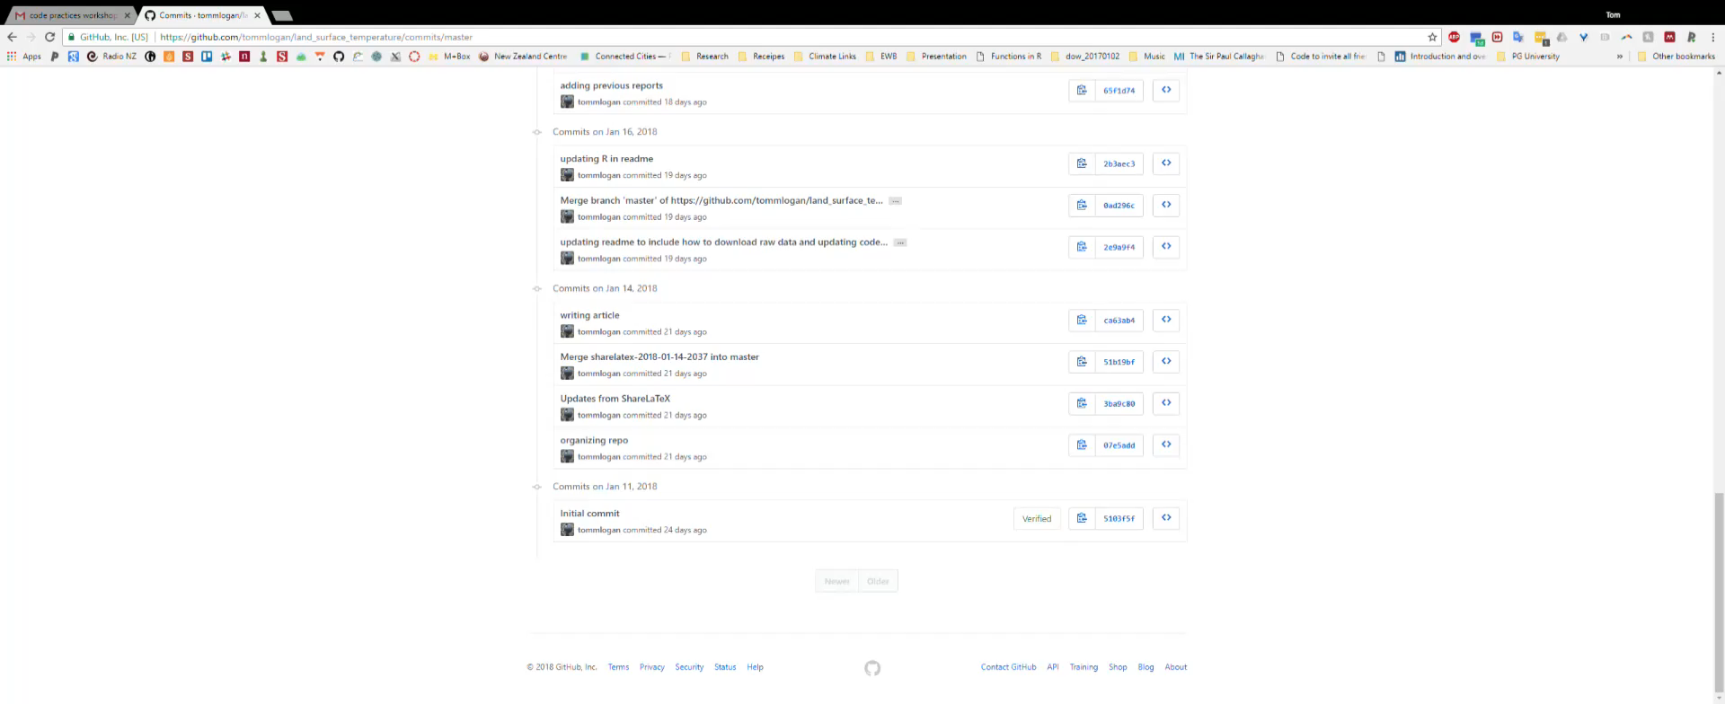
Version control

Slide 17
Basic git
Repo – repository/ project directory
Git – the version control software that Github runs
Commit – a timestamp on a set of changes
Push – send to online repo
Pull – bring onto your computer from online repo
Merge – reconciling differences in two versions
Clone – brings entire git history and files from online to computer (first pull)

Slide 18




Git (a very simple description)
Thanks NounProject for the icons:
Joe pictos
Simon Magnier
Tracy tam
Michal Kucera
Pull
Github (the cloud)
Push
Make Edits
Commit
Your PC’
(edited files)
Local git record
Your PC

Slide 19
Go
Go to github.com
Create a PRIVATE repo (unless you already have one for your project)
Name (no spaces!)
No need for readme or .gitignore yet
In the terminal (i.e. Powershell for Windows users) – cd ( into the directory where you want your project
git clone <copy from github – use https>
Move your .git folder into the directory you want if it’s not already there

Slide 20
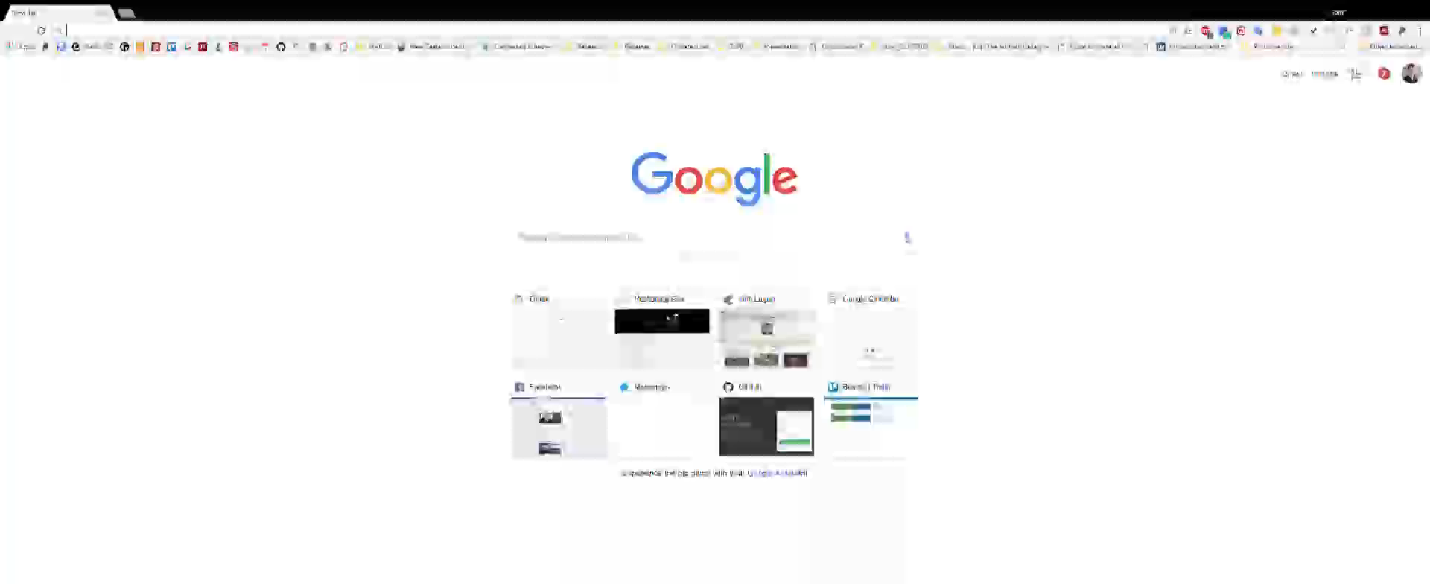
Create your repo online

Slide 21
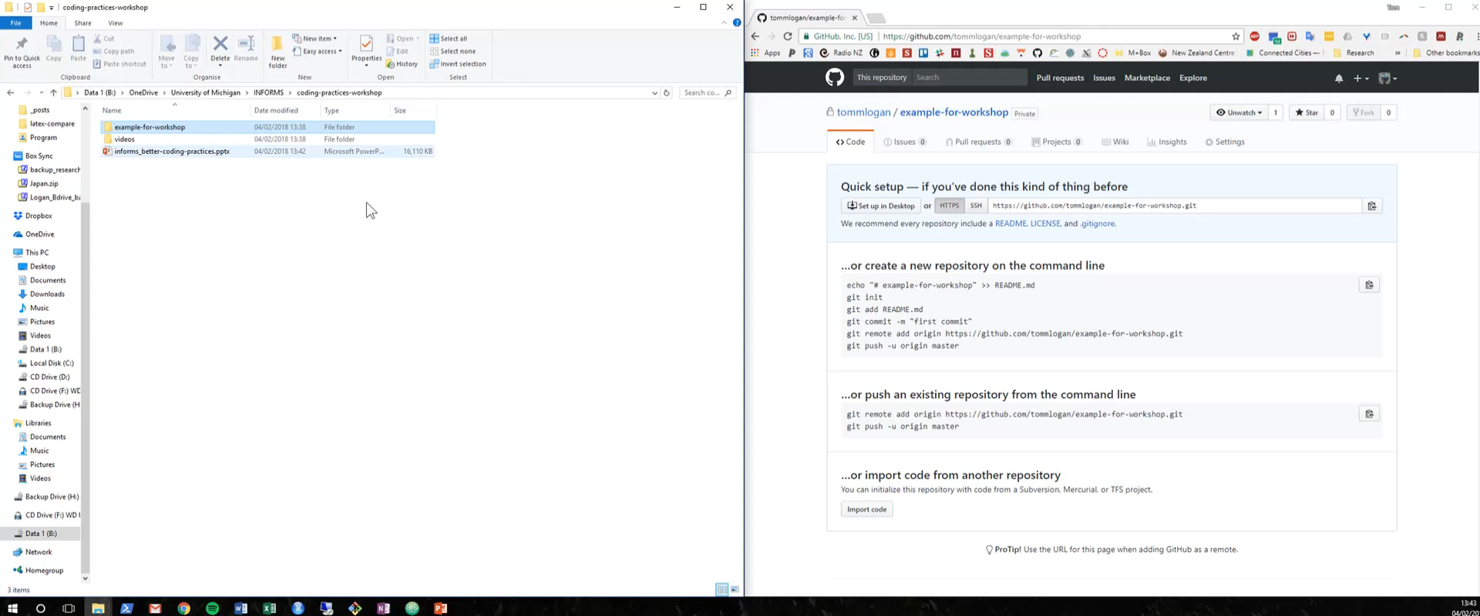
Create your repo on your computer

Slide 22
Directory
Go to your directory in your file explorer
We’re going to create the following structure
|- <your project name>/
|- .git
|- data/
|- raw/
|- processed/
|- fig/
|- exploratory/
|- final/
|- report/
|- code/ (or src) (e.g. the sub folders are project specific)
|- processing/ or data_processing
|- analysis/
|- plotting/
|- logging-code
|-_scratch/
|- .gitignore
|- README.md

Slide 23
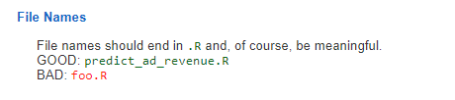
File and folder naming
Never put spaces in folders or file names (use underscores or dashes, use lowercase)
(it makes using the command line a pain when referring to folders)
R style guide:

Slide 24

Time for Atom
Open Atom
File -> Open Folder -> select your project
This should open the folder and directory on the LHS
Toggle the git tab (ctrl+shift+9 OR view->Toggle)

Slide 25
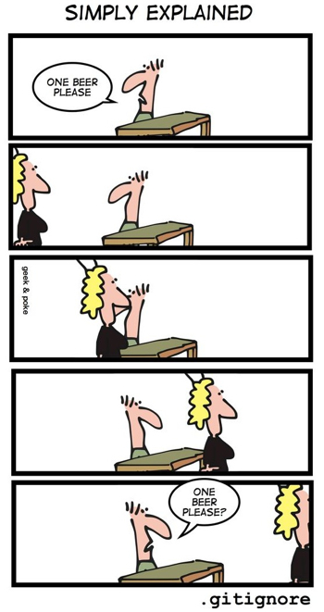
.gitignore

Slide 26
Create your .gitignore
Right click on the primary level in the directory
New File
Name it .gitignore
The .gitignore is for things you DON’T want pushed to git. This includes private info and data or files that are created by your code.
Add the following lines (there will be more)
**/_scratch
data/ (more on this later)
fig/exploratory
.log
Add other directories or file extensions you don’t want to push online (e.g. .csv, .rds, .RData, …)

Slide 27
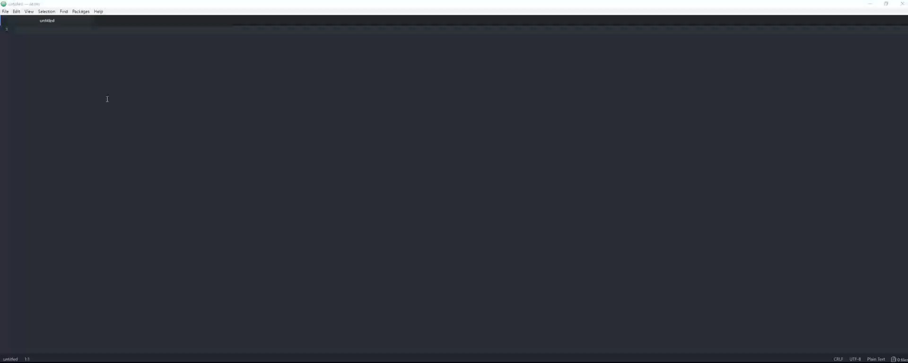
Create your .gitignore

Slide 28
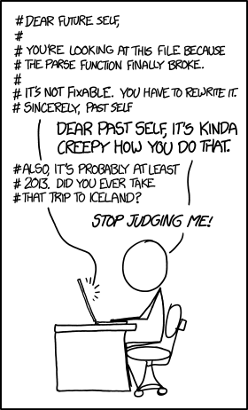
README.md

Slide 29
README.d
README.md should include:
explicit and exact recipe for how you did the analysis
assumptions you made
This is basically what you’ll put into “methods” so writing this now will make your job easier.

Slide 30

Markdown
Markdown is a plain text and quick way of writing
You can write in code blocks, math, normal, tables, lists etc.
It is how you can thoroughly document your project, what the steps are, and why
Guides
Markdown in a minute: https://www.markdowntutorial.com/
Markdown cheatsheet: https://github.com/adam-p/markdown-here/wiki/Markdown-Cheatsheet

Slide 31
Markdown
You can preview your markdown by clicking ctrl+shift+m
Code
```python
>>> print("Hello world!")
Hello world!
```
Table
| Tables | Are | Cool |
| ------------- |:-------------:| -----:|
| col 3 is | right-aligned | $1600 |
| col 2 is | centered | $12 |
| zebra stripes | are neat | $1 |

Slide 32
Write your README.md
# Land Surface Temperature
Tom M Logan
www.tomlogan.co.nz
## Description:
Understanding the factors influencing urban land surface temperature during the night and day.
## Steps:
1. Process the LandSat images to land surface temperatures
2. Statistical analysis
## 1. LandSat images to …
* This is a bullet point
…
## Code Book
<table of variable names and descriptors>

Slide 33
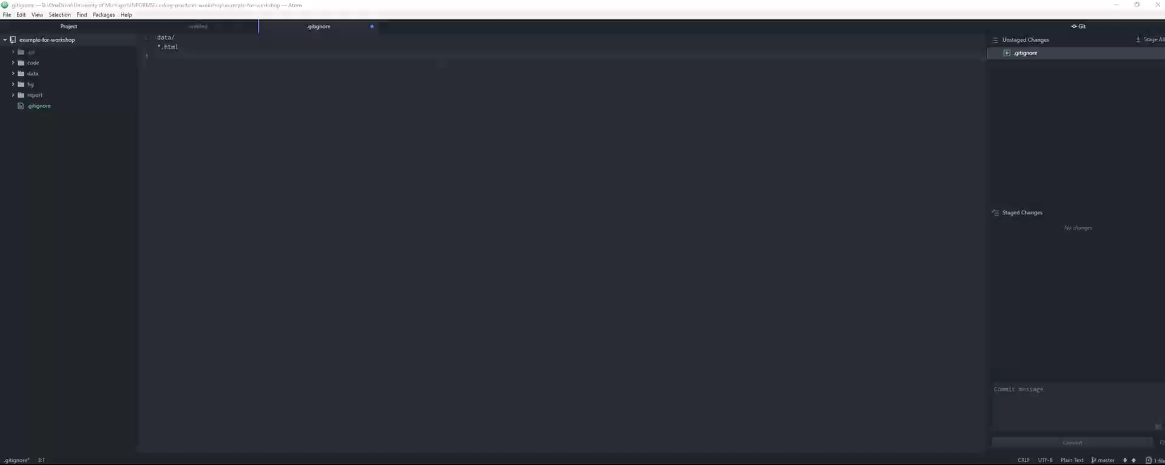
Write your README.md

Slide 34
Commit messages
Writing good commit messages
Examples of bad commit messages:
some css
styling
ooops
misc fixes and cleanups
Good messages:
add subtle background pattern to body
make subheadings larger on archive pages
fix typo in site footer
cleanup code with htmltidy

Slide 35
Make your init (initial) commit
Now it’s time to push your first changes to github
Stage your changes – on the git panel – “Enter” toggles the stage
Stage is any you want to be included in your next commit.
Write your commit message “init commit”
Commit – Ctrl Enter
Push
Now go to your github.com repo and see the new changes!

Slide 36
If you have an existing repo
If you have existing files and folders in the repo:
After you’ve created your .gitignore
Using the terminal or powershell
cd into the correct directory (as shown before)
Type:
git status (this should list the tracked and untracked files – files you don’t want on git should not be shown! If they are, your .gitignore is wrong)
git add . (this ‘stages’ all the files and folders in the directory – i.e. git is now ‘tracking’ these files)
git commit –m ‘<add your message here>’ (either commit here or in Atom)
git push –u origin master (push here or in Atom – what this says is you’re pushing updates onto the master (or primary) repo)

Slide 37
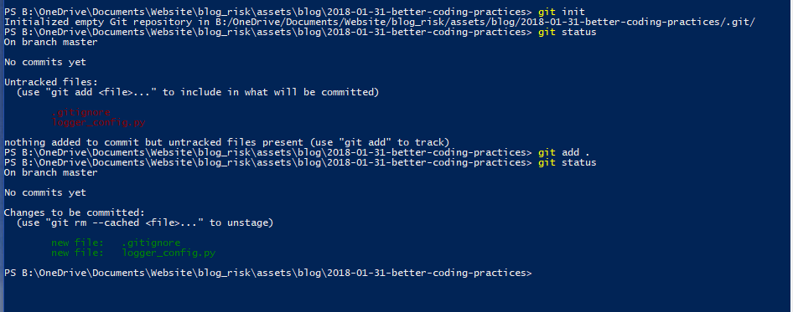
If you have an existing repo

Slide 38
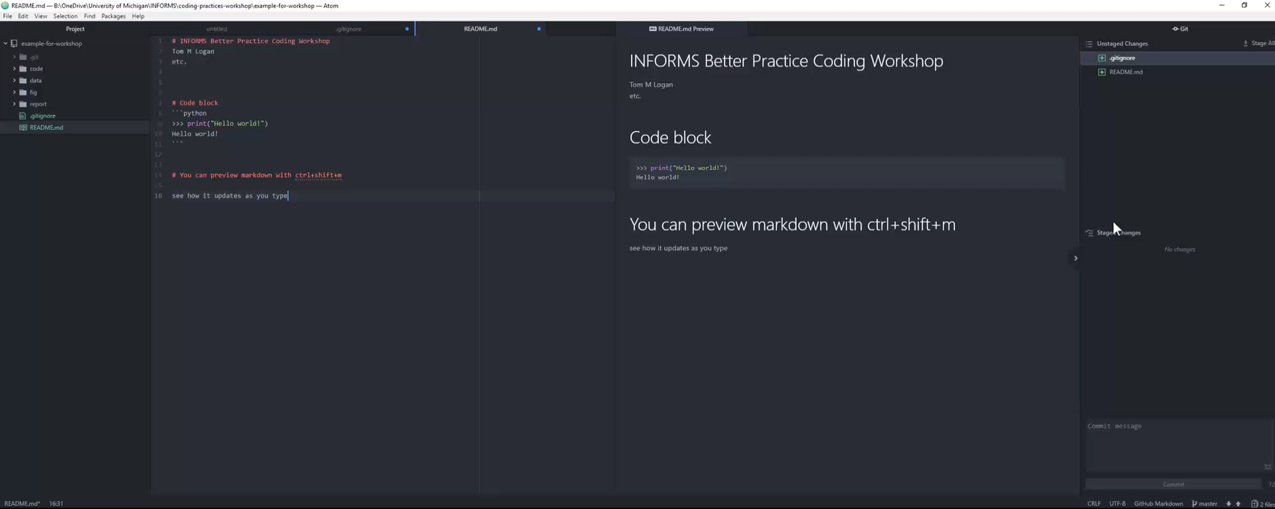
Make your first commit

Slide 39
RStudio
Rstudio provides a nice interface similar to Atom for use with R projects
Open Rstudio
File -> new project
Existing Directory
This will create a .Rproj file in the directory
Setup a project – use markdown – push/pull/commit etc.

Slide 40
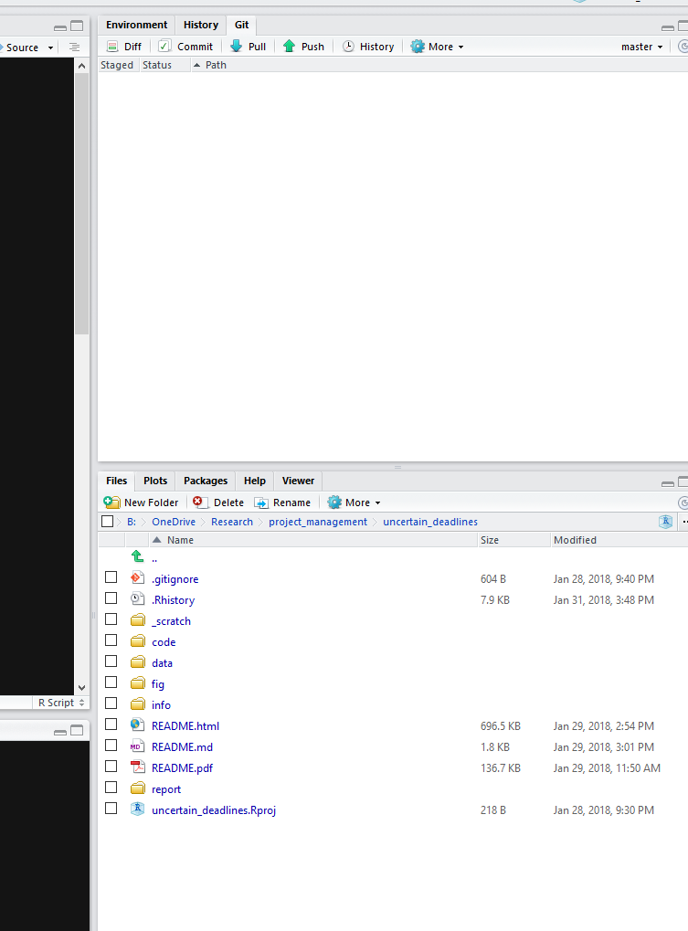
Rstudio
This should put a git option on the RHS bar and the file directory
Open .gitignore
Add .Rhistory and .html and .Rproject and .Rdata
You should see the changes appear in the git tab
Open README.md – preview it
Commit and push!

Slide 41
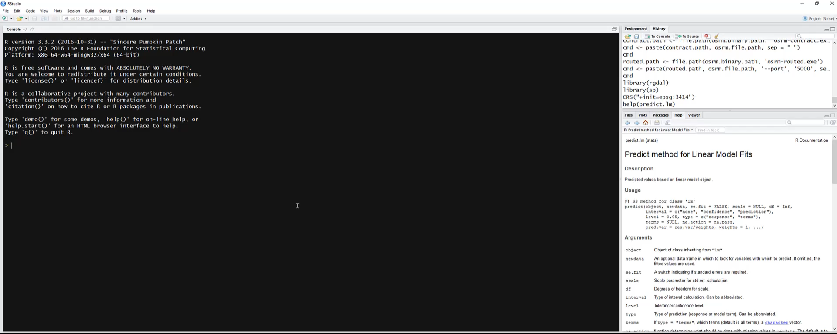
Using Rstudio

Slide 42
Reproducibility and code clarity
Code book (depends on size of data, but if you’re doing statistics, there must be somewhere that records the var_name and description)
Human readable is not the same as computer readable
In your README.md have a table with
var_name | description | unit
Detailed README.md

Slide 43
Repo structure
|- <your project name>/
|- .git
|- data/
|- raw/
|- processed/
|- fig/
|- exploratory/
|- final/
|- report/
|- code/ (or src) (e.g. the sub folders are project specific)
|- processing/ or data_processing
|- analysis/
|- plotting/
|- logging-code
|-_scratch/
|- .gitignore
|- README.md

Slide 44
Code
You may find having different scripts for the following useful:
Processes raw data into processed data
Analyse processed data
Plotting functions (which may be called from the analysing function)
Logging (so you can call this from other scripts)

Slide 45
Code style
Python
https://www.python.org/dev/peps/pep-0008/
R
https://google.github.io/styleguide/Rguide.xml
Every language has a style guide. Know yours.

Slide 46
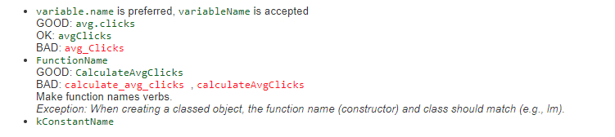
Code function and variable names
R
Python
“Function names should be lowercase, with words separated by underscores as necessary to improve readability.”
“Variable names follow the same convention as function names.”

Slide 47
Repo structure
|- <your project name>/
|- .git
|- data/
|- raw/
|- processed/
|- fig/
|- exploratory/
|- final/
|- report/
|- code/ (or src) (e.g. the sub folders are project specific)
|- processing/ or data_processing
|- analysis/
|- plotting/
|- logging-code
|-_scratch/
|- .gitignore
|- README.md

Slide 48
Data
raw data is anything that you download or collect
It has NO processing
All processing should be in a script file – e.g. you should be able to run a script and it’ll create the processed data
“Reporting manipulated data as raw data is a very common way to slow down the analysis process, … forensic study of data to figure out why the raw data looks weird” – Leek, How to be a Modern Scientist (p30)
processed data (tidy data set) is what you analyse

Slide 49
Data uploading (case dependent!)
Data can be uploaded to git… but not through the normal way. Use git lfs
Ideally just upload a zipped version of your raw data (which can get converted to the processed/analysed data) and the data on which you run your analysis.
Alternatively you can get a DOI for data that you upload to Figshare – it’s free if it’s public – so post your raw and analysis data there once you’re accepted!

Slide 50
Repo structure
|- <your project name>/
|- .git
|- data/
|- raw/
|- processed/
|- fig/
|- exploratory/
|- final/
|- report/
|- code/ (or src) (e.g. the sub folders are project specific)
|- processing/ or data_processing
|- analysis/
|- plotting/
|- logging-code
|-_scratch/
|- .gitignore
|- README.md

Slide 51
Fig
Any analysis with data starts with exploring the data (or should! See Leek’s book The elements of data analytic style)
Create figures
Add to fig/exploratory
These don’t have to be pretty! – just make sure you record how you created them (or name the axis appropriately)
fig/final is for the pretty figures that’ll go into report or presentations

Slide 52
Repo structure
|- <your project name>/
|- .git
|- data/
|- raw/
|- processed/
|- fig/
|- exploratory/
|- final/
|- report/
|- code/ (or src) (e.g. the sub folders are project specific)
|- processing/ or data_processing
|- analysis/
|- plotting/
|- logging-code
|-_scratch/
|- .gitignore
|- README.md

Slide 53
Report
Regardless of word or latex – version control will be useful
ShareLaTeX has seamless integration with Git
This works great with .bib files that you output from Paperpile or Mendeley

Slide 54

ShareLaTeX
Check out my blog comparing ShareLaTeX, OverLeaf, Google Docs, and Word:
http://reckoningrisk.com/research-practice/2017/comparing-editors-for-reports/

Slide 55
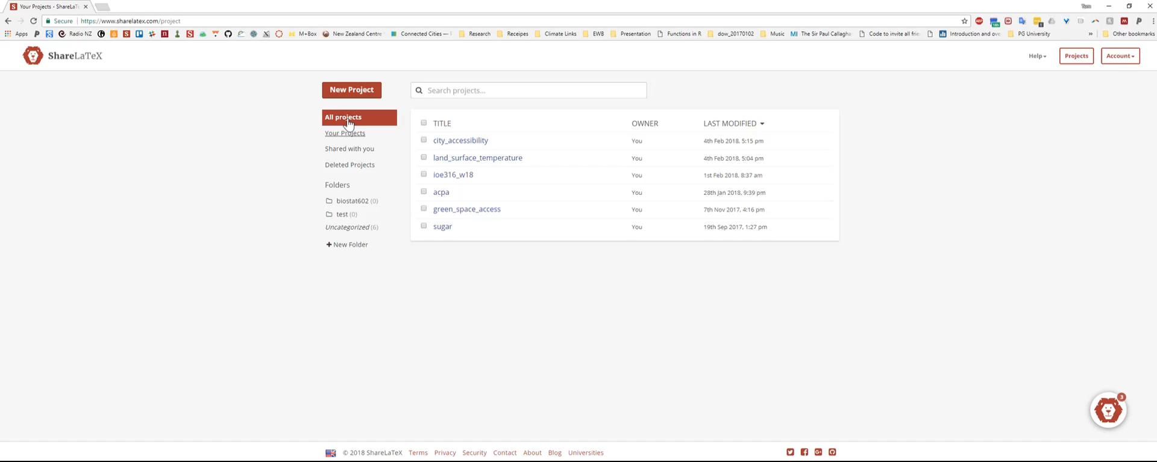
ShareLaTeX example

Slide 56
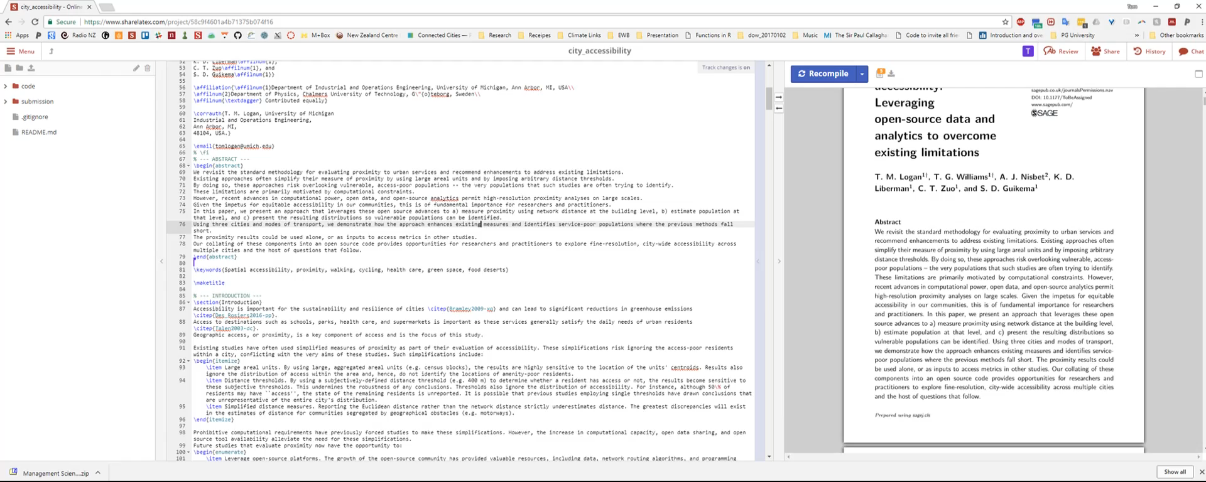
ShareLaTeX collaborative example

Slide 57
UM LaTeX thesis template
Thanks to Peter Nilsson, there is a UM thesis template in LaTeX:
https://github.com/pettni/um-thesis

Slide 58
Logging
(Better) alternative to print statement
Records in a .log file (txt file) the record and timestamp which can be super useful for debugging
Different levels of logging (e.g. error, warning, info, debug)
Can set it up in python using code I’ve made available online
Log a place in the code with
>> logger.info(‘The code is doing something’)

Slide 59
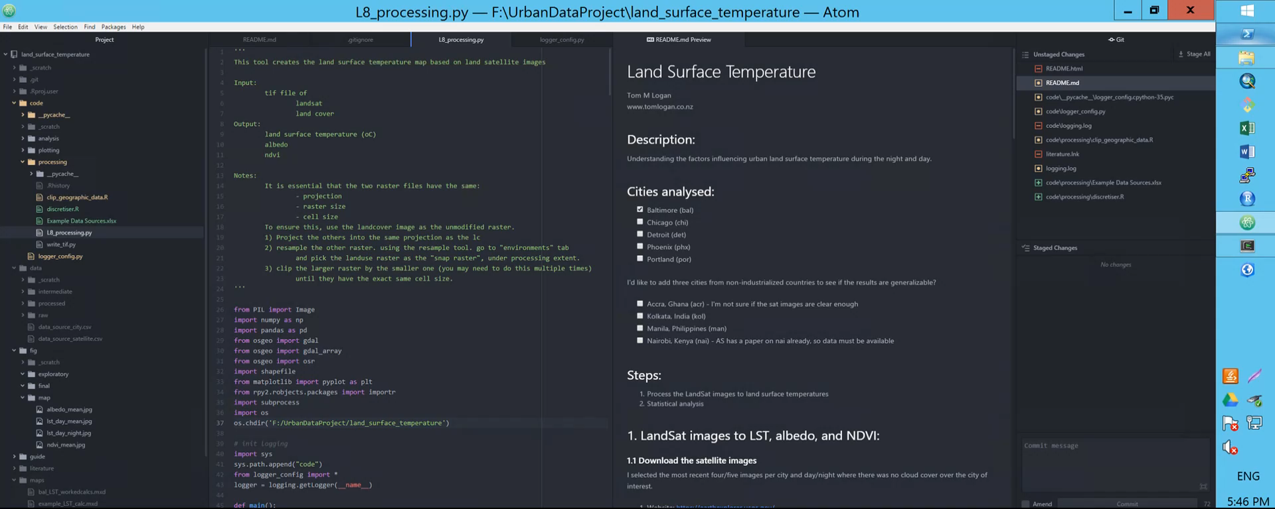
Logging

Slide 60

Paperpile – citation manager
Check out our blog discussing Paperpile:
http://reckoningrisk.com/research-practice/2017/literature-reviews/

Slide 61
Other random thoughts while I put this together
Learn to touch type: https://www.dancemattypingguide.com/dance-mat-typing-level-1/
If you want to use git without atom, that’s fantastic and you should know how to do it. A simple guide http://rogerdudler.github.io/git-guide/

Slide 62

Shout out:
If you’re looking for a break from research, check out:
Adventure racing, rogaining, and orienteering
Orienteering – known as “the thinking sport” involves searching the woods for flags with a map and compass.

Slide 63

Tom Logan
reckoningrisk.com
tomlogan@umich.edu
@tomMLogan

